Slide 1

GOOD MORNING….

Slide 2


Slide 3

SAI GOKULA SEVA SAMSTHE(r)

Slide 4
ABOUT OUR SGSS
Sai Gokula Seva Samsthe @, is a NGO. It was set up in the year 2004, by our beloved Chairman/Founder, Shri. A. M. Rajendra Prasad. It was his dream of rendering services to the society for the upliftment and betterment of the urban part of community.
To do any job, first we need to gain good knowledge and experience so that we can be the better and progress. So, our Chairman /Founder rendered his 20 years of service in Shathashrungha Ashram, Kengeri.
Everyday was a learning experience as the days were passing by. Years passed on and today here we stand as one of the best NGO who is serving the needy.

Slide 5
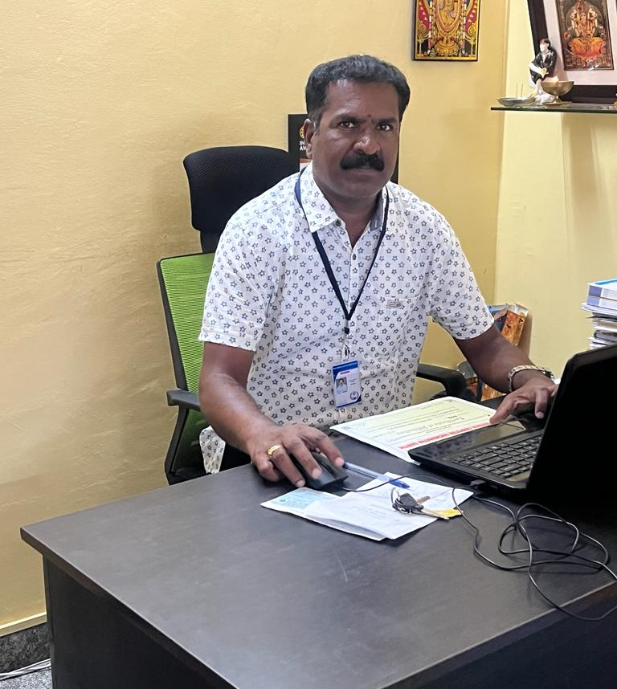
CHAIRMAN AND FOUNDER
SHRI,
A.M. RAJENDRA
PRASAD

Slide 6
ABOUT OUR CHAIRMAN AND FOUNDER
Our Founder & Chairman Shri. A. M. Rajendra Prasad.He was born in the year 1972, in a village.
He was bought up well and he completed his Schooling in T. Agrahara. Later, for the further studies he had to move to his uncle's home at KR PURAM.
He completed his degree in Bachelor of Arts. He also did his ITI in Mechanical studies.
He rendered his services, in Shathashrungha Ashram, under the supervision and guidance of his Excellency Sri. Ram Prasad Guruji.

Slide 7
ADDRESS: Sri Ranga Building, 5TH cross, T G Extension, Hoskote Town-562114, Bangalore Rural Dist. Karnataka, India. CONTACT NUMBERS: Ph: +919945329169/7625041380. E-MAIL ID: prasad@sgsstrust.org vani@sgsstrust.org WEBSITE: www.sgsstrust.org Registered under Trust Registration Act Reg. No. KR1-4-00504-2005-06-00191-17-18.
SAI GOKULA SEVA SAMASTHE (R) (SGSS)

Slide 8
OFFICE INFORMATION CELL
PAN : AAGTS8342D
TAN Number : BLRS55529F
12A: Registration Number - AAGTS8342DE20080-24/09/2021
80G: Registration Number - AAGTS8342DF20211-24/09/2021.
FCRA: Registration Number - 094370008.Under economic, education, social regd. under Ministry of home affairs, Foreigners division.
Guide Star Number (GSN) : 10277
Darpan (NITI Aayog, Government of India) ID : KA/2009/0010703
CSR1 Registration No : CSR00008964
ISO 9001: 2015 Reg No : 305021062113Q

Slide 9
OUR TRUST ACCOUNT
Bank Name : State Bank Of India, SME Branch Hoskote, Bangalore Rural (D) – 562114
IFSC Code: SBIN0011293
Account number: 37117428205
MICR Code: 560002138.
FCRA ACCOUNT
Account NO: 40882569878
IFSC CODE: SBIN0000691
Address: FCRA cell, 4th floor, State Bank of India, New Delhi Main Branch, 11, Sansad Marg, New delhi-110001.
MICR Code: 110002087

Slide 10
VISION OF SGSS
“Sai gokula is decided to the holistic development of the under privileged and marginalized of our society through the expansion of proper utilization of their capabilities. It is facilitating sustainable initiative in the target community, empowering women and child and promoting education and health.”

Slide 11


WOMEN EMPOWERMENT
“A woman with a voice is by definition a strong woman. But the search to find that voice can remarkably difficult.’’

Slide 12
SGSS ON WOMEN EMPOWERMENT AND CHILD CARE…
“Women’s empowerment” refers to the process of enhancing women’s access to control over the strategic life decisions that affect them as well as access to the opportunities that allow them to fully realise their potential.
It is based on the assumptions that women and men differ from one another in their social positions and that these differences consist of asymmetric, unequal power relations between the sexes.
In order to improve women’s quality of life, the process of women’s empowerment as an economic, political, and sociocultural process challenges the system of sexual stratification that has led to women’s subjugation and marginalisation.

Slide 13
An empowered woman is able to give better education to her kids and also able to take care of everyone when she has the power of decision making.
A successful woman inspire many other women in the community. Hence, eventually overall community will see path of development.
We have found many such programs which can be combined to create more effective, responsive, inclusive, and accountable institutions for women empowerment.

Slide 14
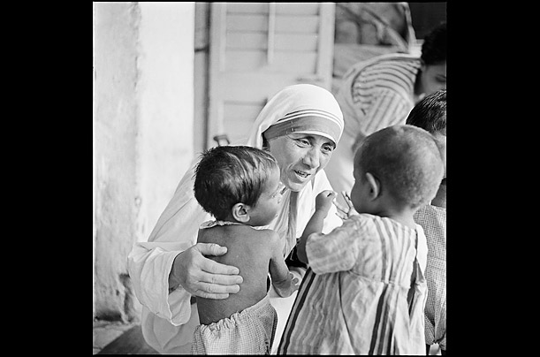
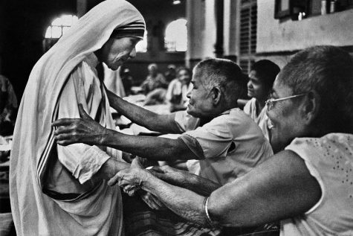
HOME FOR HOMELESS.....
“We think sometimes that poverty is only being hungry, naked and homeless. The poverty of being unwanted, unloved and uncared for is the greatest poverty. We must start in our own homes to remedy this kind of poverty.”

Slide 15
SGSS ON HOME FOR HOMELESS
The Sai Gokula Seva Samsthe (S) Trust provides Homeless Shelters and Homeless Service Organizations.
This includes all resources necessary to help the needy. Volunteer Opportunities are also needed at most shelters. I have listed contact information for volunteering at these shelters.

Slide 16
SKILL DEVELOPMENT
Skill development is the cornerstone of individual and societal progress. It empowers individuals to adapt to changing circumstances, enhances employability, and fosters innovation.
We must recognize that the skills required in the job market today may differ significantly from those of yesterday. Therefore, a commitment to lifelong learning and skill enhancement is crucial.
Moreover, investing in skill development is an investment in economic growth and social well-being.

Slide 17

In conclusion, the journey towards a skilled and empowered society requires collective effort and unwavering commitment.
Let us, embrace a culture of continuous learning, foster innovation, and cultivate the skills that will propel us into a future of endless possibilities.
Together, we can build a workforce that not only meets the demands of today but also shapes the challenges of tomorrow.

Slide 18
ROLE OF SGSS ON SKILL DEVELOPMENT
EDUCATION FOR STREET CHILDREN :
Sai Gokula Seva Samsthe Trust intends to bring the street children to the mainstream of the society by identifying the street children, counselling them and making arrangements for the children to get admitted to Government schools.
SPECIAL SCHOOL FOR CHILD LABOUR:
Sai Gokula Seva Samsthe Trust intends to bring the children involved in child labour to the mainstream of the society by identifying them, educating them and making arrangements for the children to get admitted to Government schools.

Slide 19
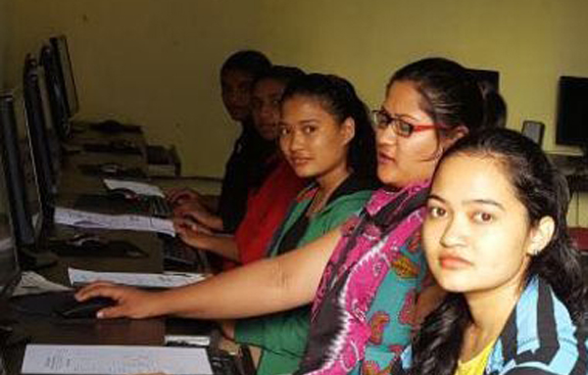
COMPUTER TRAININGS…
Sai Gokula Seva Samsthe Trust conducts computer training for eligible candidates under the “National Digital Literacy Mission”.

Slide 20
SGSS SERVICES ON OLD AGE HOMES
“Sai Gokula Seva Samsthe” Trust proposes to start a Old Age Home.
Old age homes have become an increasingly relevant aspect of the evolving Indian society due to various factors.
URBANIZATION:
The importance of old age homes are becoming more prominent as they offer a comfortable and secure living space for seniors while providing companionship, care and independence.

Slide 21
SUPPORTING THE UNDER PRIVILIGED:
India’s elderly population is projected to reach 340 million by 2050 from 138 million in 2021. Many of these elderly have limited family support and face financial insecurity, social isolation, and health problems.
In some of the worst case scenarios, they are subject to physical abuse and abandon, not to mention the psychological upheaval. The importance of old age homes in India cannot be overstated as they provide the basic amenities and support to a vulnerable population..

Slide 22
MISSION OF SGSS
“Sai gokula stands for Committed to provide a way for better society by supporting the poorestural and urban through being the preferred social service provider, contributing to the social & environmental prosperity of Karnataka.”

Slide 23

“THE PATH OF PHILANTROPY”………
“Charity begins at home but should not end there.”

Slide 24
OUR SAI GOKULA CONCERTS WITH I2U FOUNDATION DONATES THE STUDENT MATERIALS….
I2U SOCIAL FOUNDATION is a Private Limited Company, incorporated under the Companies Act as a Company limited by Shares. It is classified as Non-govt Company and is registered at RoC-Delhi.
This program will Organized the I2U foundation of Birla Soft Company. First we have to Thanks them. So their helping a poor peoples and dropout peoples for leading the some instruments of students. The i2U foundation is a NGO support Co-systems so assist a company’s individuals and other citizen stakeholders. They are working across India and their donating Exam pads and pens for Sai Gokula NGO.

Slide 25
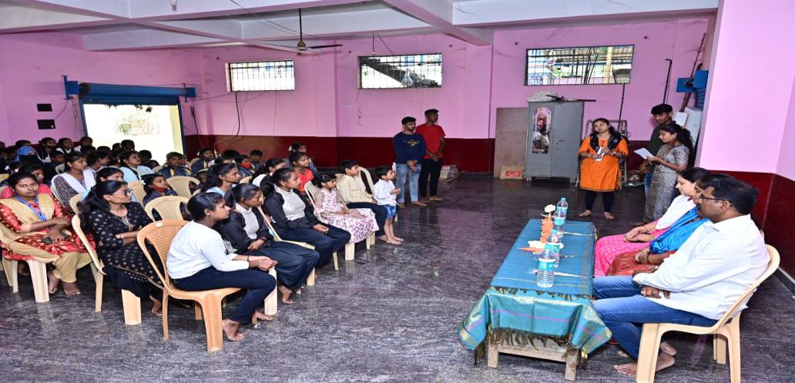
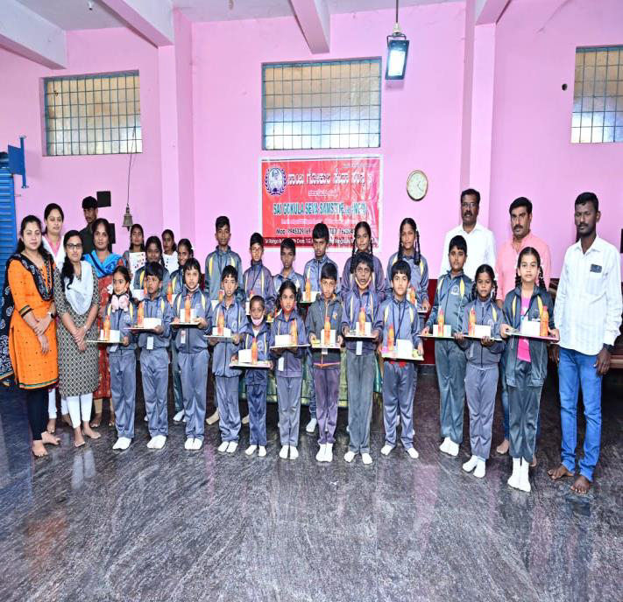

Slide 26
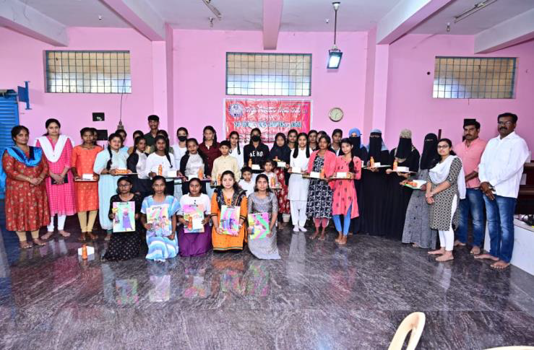
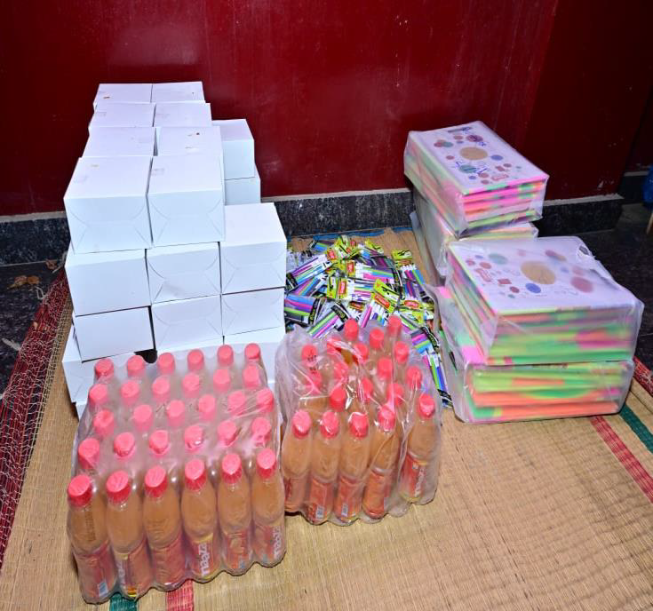

Slide 27
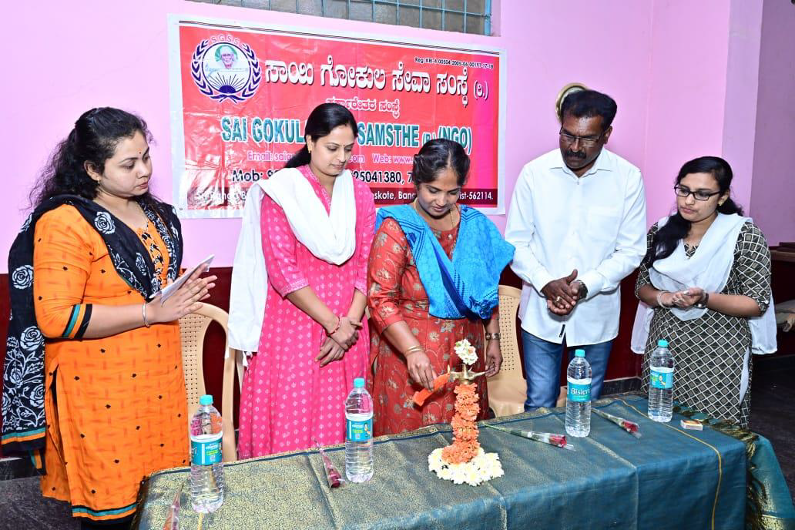
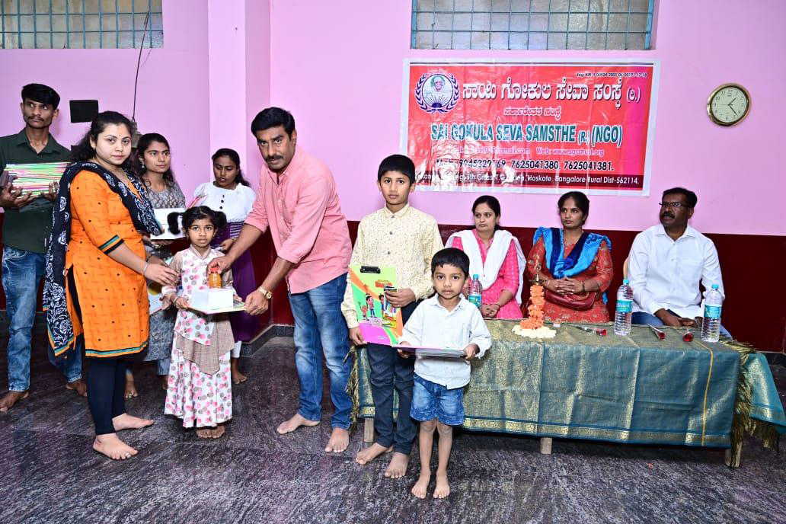

Slide 28
THE ROLE OF NGO'S IN NATION BUILDING………….
“The purpose of an NGO is to focus on all topics relating to human rights, social issues, environmental issues, and advocacy. They strive to develop and improve society's social and political conditions on a large scale. The following are some of the NGO's functions: Human rights and child rights.”

Slide 29
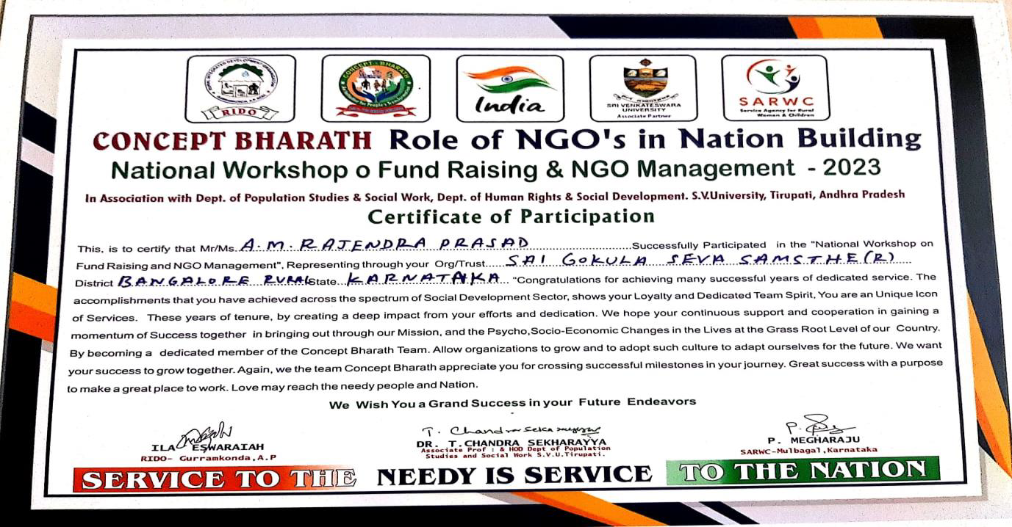

Slide 30
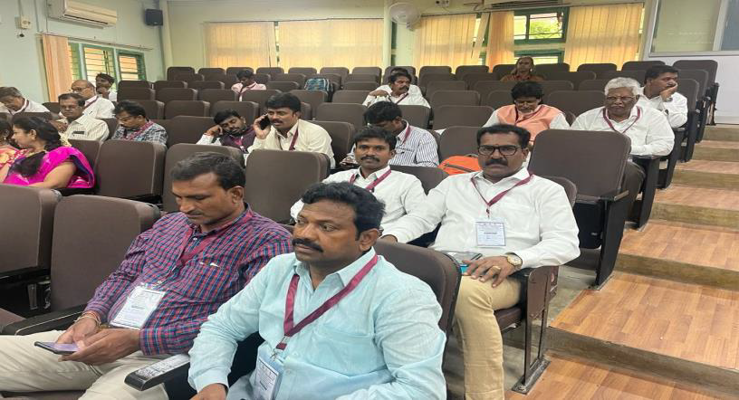
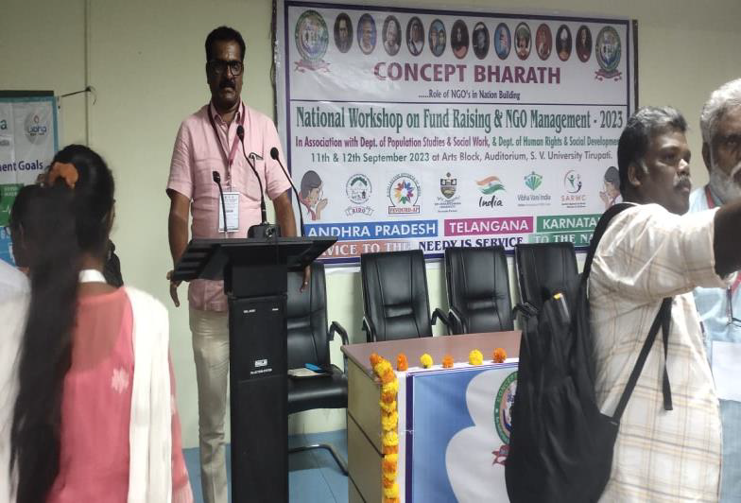

Slide 31
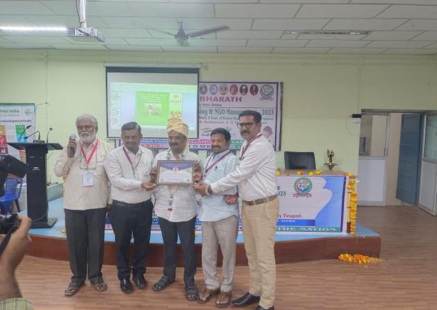
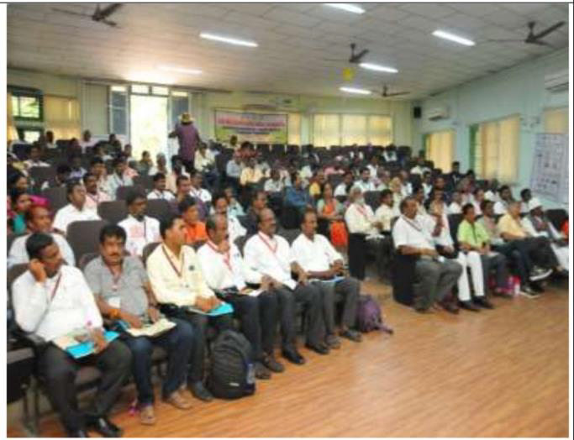

Slide 32
DIGITAL MARKETING PROJECT(2022-23) IN ASSOCIATION WITH SMILE FOUNDATIONS HEXAWARE…
Digital marketing has hugely transformed the techniques adopted by different brands and businesses for marketing their products or services. People nowadays are more inclined towards online content which makes Digital Market a popular niche for digital knowledge.
Through the foundation course of “DIGITAL MARKETING”, students will learn about this cutting edge technology and its importance in the current business market.

Slide 33
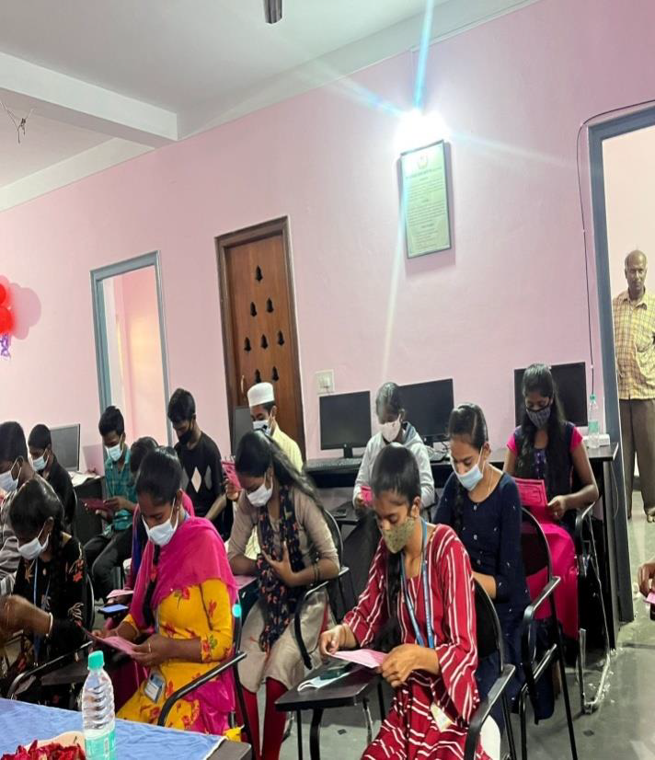
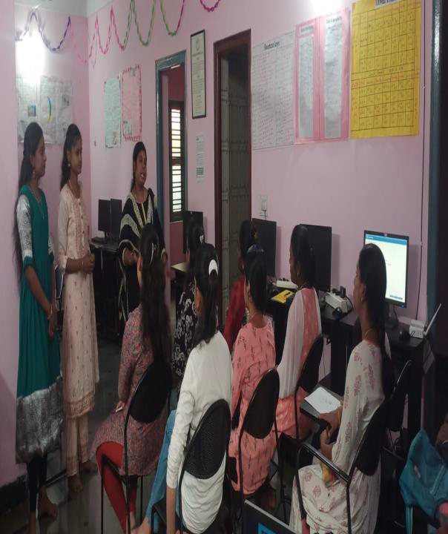

Slide 34
THIS COURSE IS IDEAL FOR:
Fresher’s
Sales and marketing people
Business Owners(Big or Small)
Marketing Professionals
Sales Professionals
IT professionals
Students (Any Background)

Slide 35

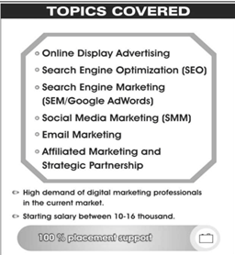

Slide 36
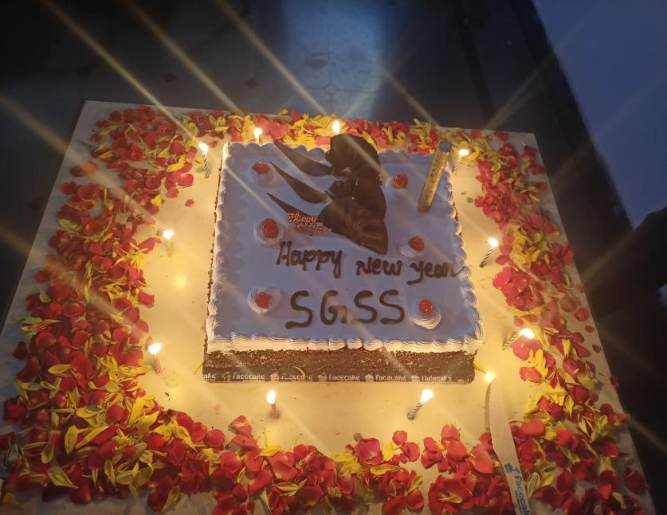
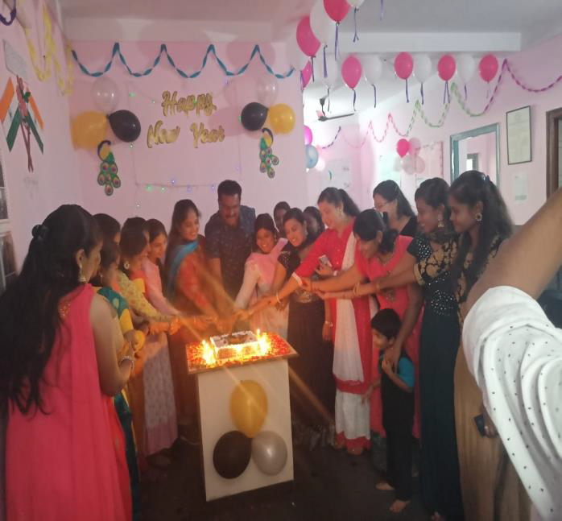
NEWYEAR CELEBRATIONS OF SGSS.....

Slide 37
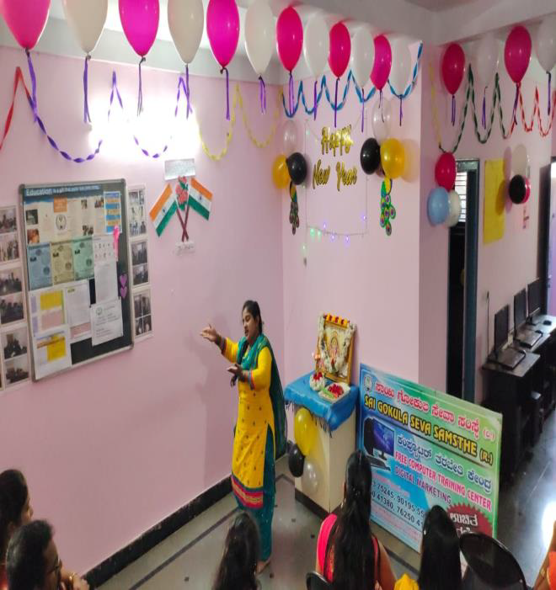
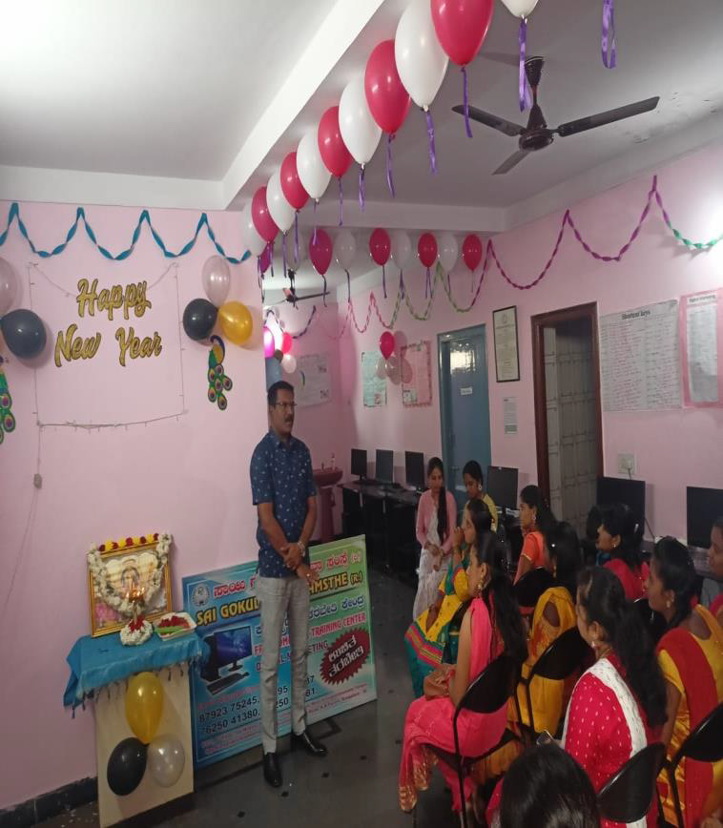

Slide 38
HEALTH CARE PROJECT (2022-23) IN ASSOCIATION WITH ERICSON AND SMILE FOUNDATION…..
“The mission of the Health Project is to seek out, evaluate, promote and distribute quality health promotion/disease prevention programs .”
With the objectives of :
Providing appropriate quality care
sharply reducing the rate of healthcare inflation by holding down unnecessary expenditures.

Slide 39
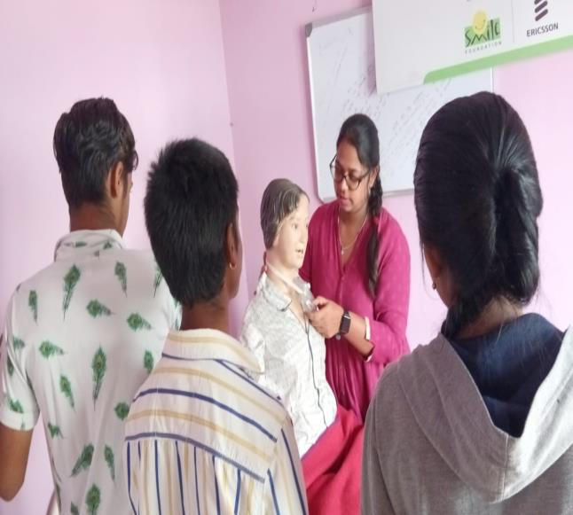
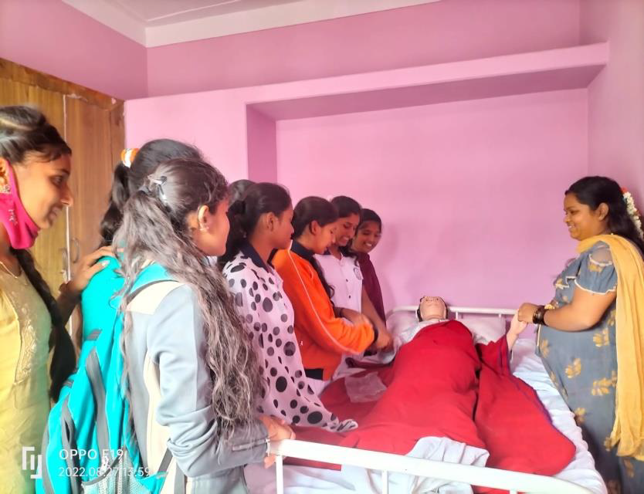

Slide 40
PROGRAMS AND SERVICES….
INFORMATIONAL APPPROACHES : Directed at changing knowledge or attitudes about the benefit so find opportunities for healthy lifestyles
BEHAVIOUR OR SOCIAL APPROACHES : Designed to teach employees the behavioral management skills necessary for successful adoption and maintenance of behavior change.
WORKPLACE HEALTH PROBLEMS : They are not add – on benefits but basic investments in human capital, similar to training, mentoring, and other employee development programs.

Slide 41
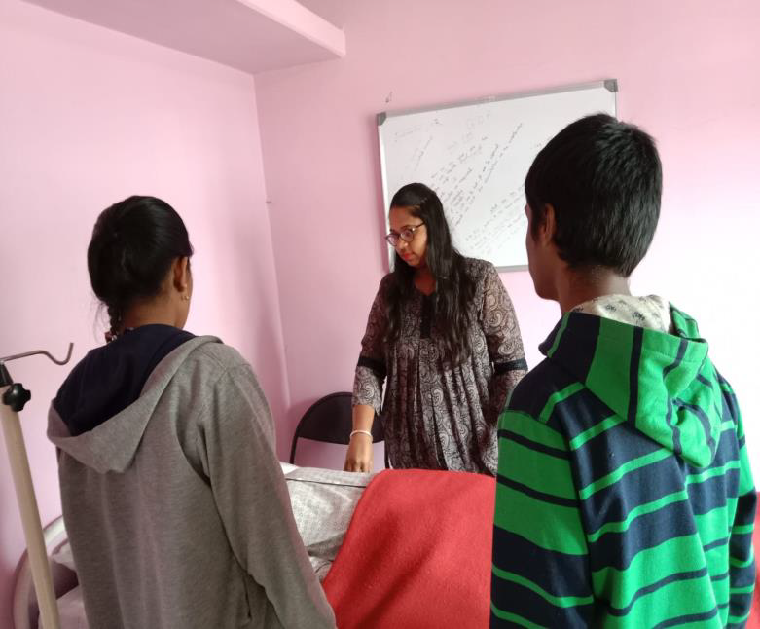

Slide 42
SGSS ON QUEST ALLIGANCE COURSE
Young people are in a vulnerable state in the labour market. Many of them lack the skills, work experience, job-search abilities and financial resources to find employment. Youth make up 25 per cent of the global working-age population, yet they account for 40 per cent of total unemployment.
SGSS made a motto to enhance the skill development in youth , through this “QUEST ALLIGANCE COURSE”.

Slide 43
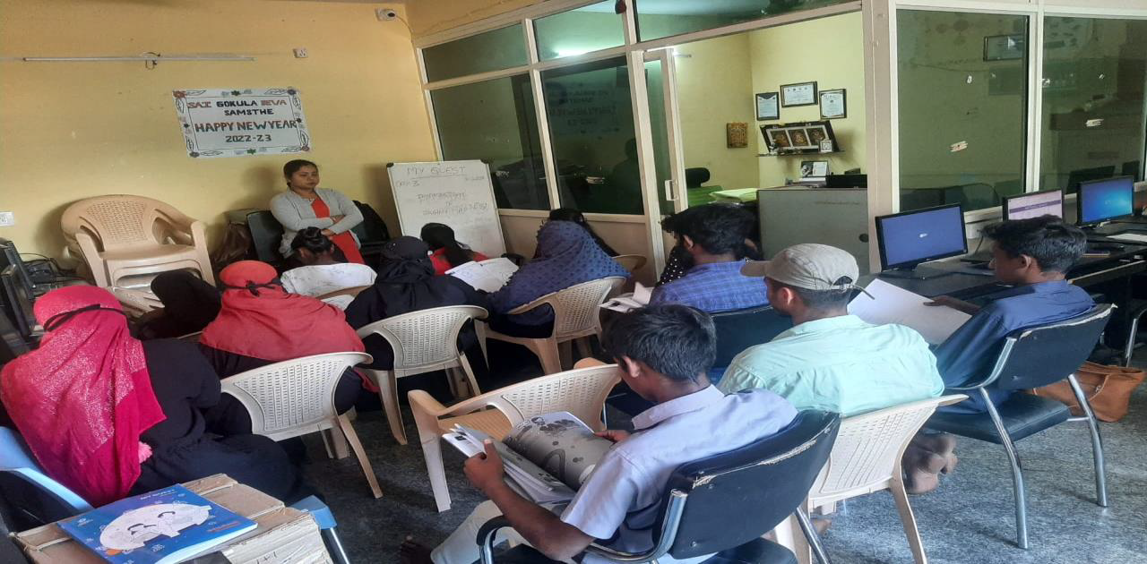
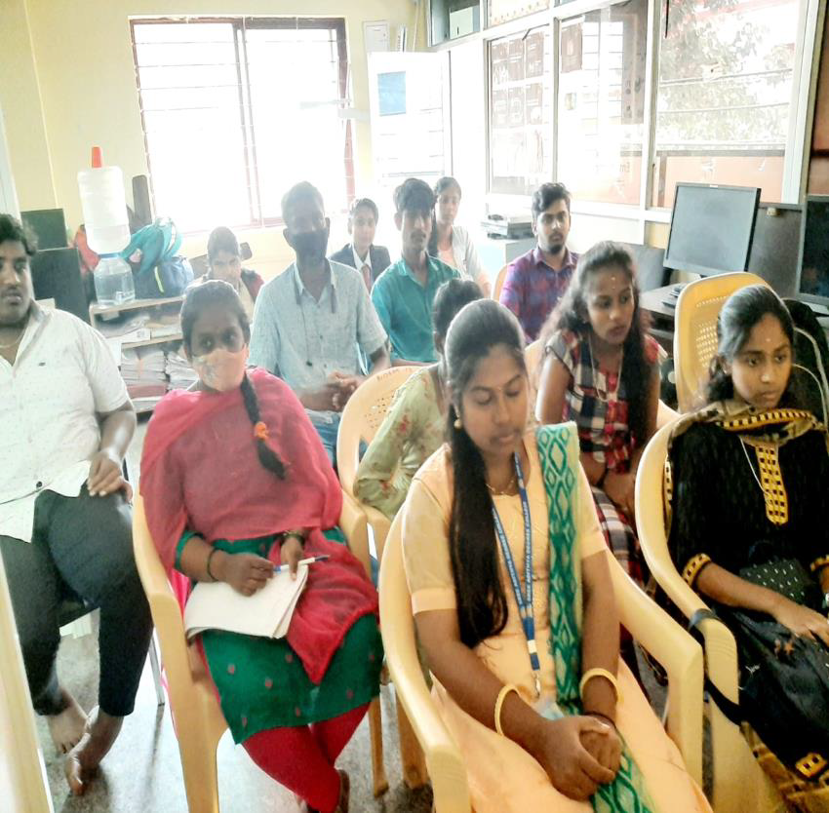

Slide 44
OUR APPROACH TOWARDS THE COUSRSE….
This is the Youth Employability Program Course. It is a Completely Online learning Course we are providing free Youth Employability program. The Course is 3 month Duration after the completion of the training 100% placement will be given and with the course completion certificate. It is a online learning And the First students are registered in a “QUEST APP” in that all the lessons are available.
The Quest App totally 13 subjects are there so we have to choose 5 to 6 toolkits in that i,e Communication Skills (BasicEnglish,Advanced English), Digital Skills, Life Skills, Career Skills and Job Readiness. The Students are Learning These subjects in the QUEST APP. It is very useful for a New learners and students. They are learning so many new things in this course.

Slide 45
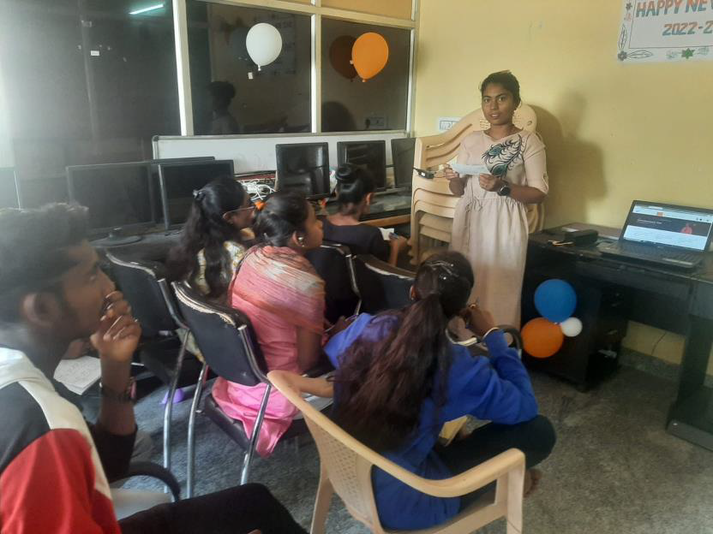
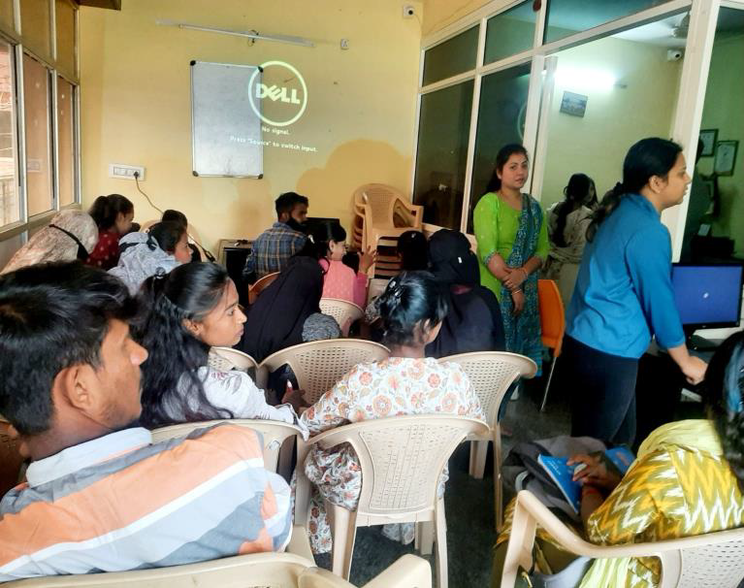

Slide 46
LETTER OF INTENT TO DONATE BY XENCIO…..
Greetings to “XENCIO” company for their commendable efforts in contributing laptops and desktops to promote education.
Your commitment to providing valuable services is truly appreciated.
KEEP MAKING A POSITIVE IMPACT!
WITH REGARDS,
- SAI GOKULA SEVA SAMASTHE (R).

Slide 47
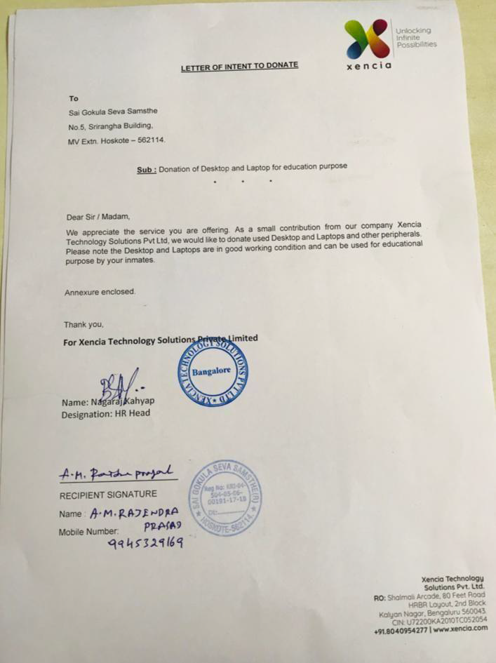
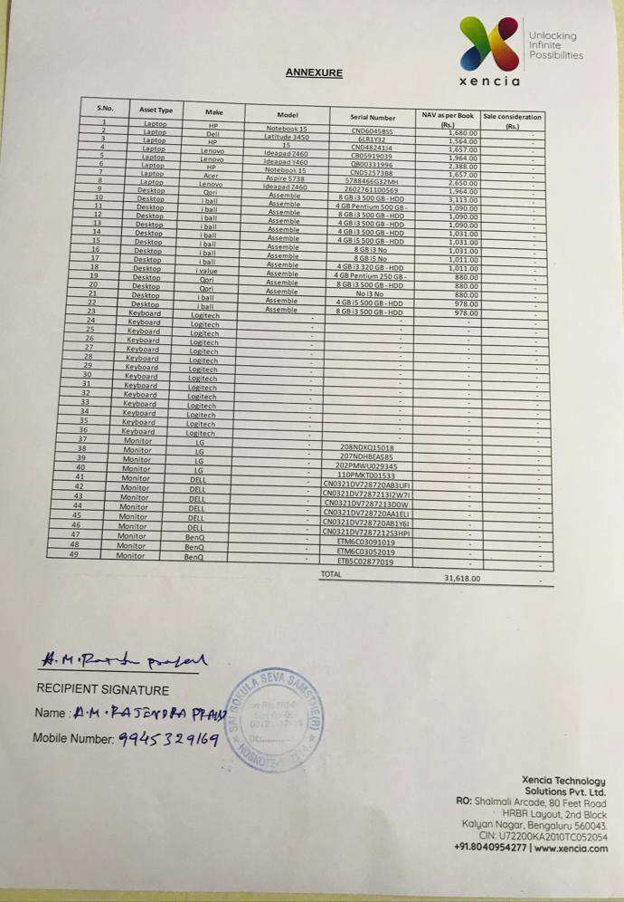

Slide 48
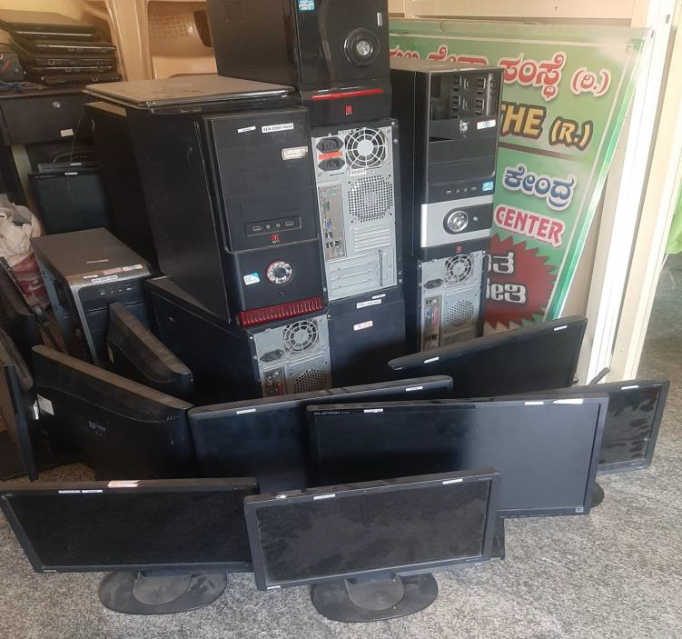
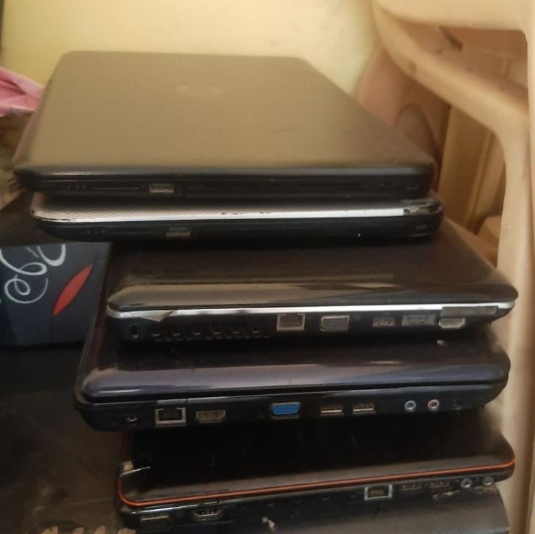

Slide 49
OUR NDLM CENTRES AND PROGRAMS:
The “National Digital Literacy Mission” (NDLM) aimed to make at least one person in every household digitally literate. NDLM centers were established to provide training in basic computer skills. Programs included courses on using computers, the internet, and digital devices to enhance digital literacy among citizens.
We were very happy to be a part of this change that was bought in by us with the NASSCOM FOUNDATION. We were the core partners. Very proud to also mention that we have trained around 6000+ beneficiaries so far under this scheme.

Slide 50
We had 4 Centres in and around Bangalore rural region to take up this mission into vision-1.
ERICSON NDLM Centre at Hoskote.
ATOS NDLM Center at Bidarahalli.
Infosys Foundation NDLM Centre at Bangarpete.
Infosys NDLM Centre at Hoskote.
CGI NDLM Center at Bidarahalli.
CGI NDLM Centre at KR Puram.

Slide 51
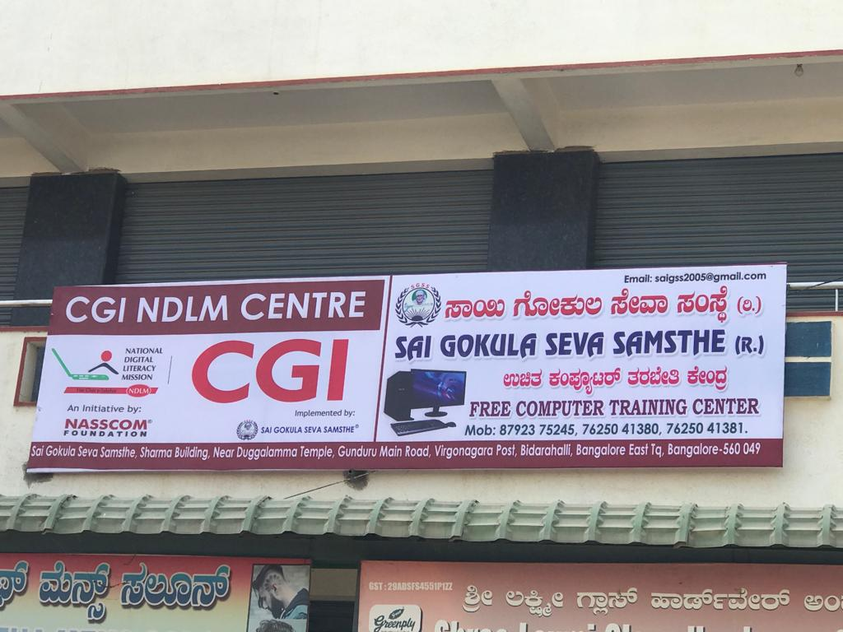
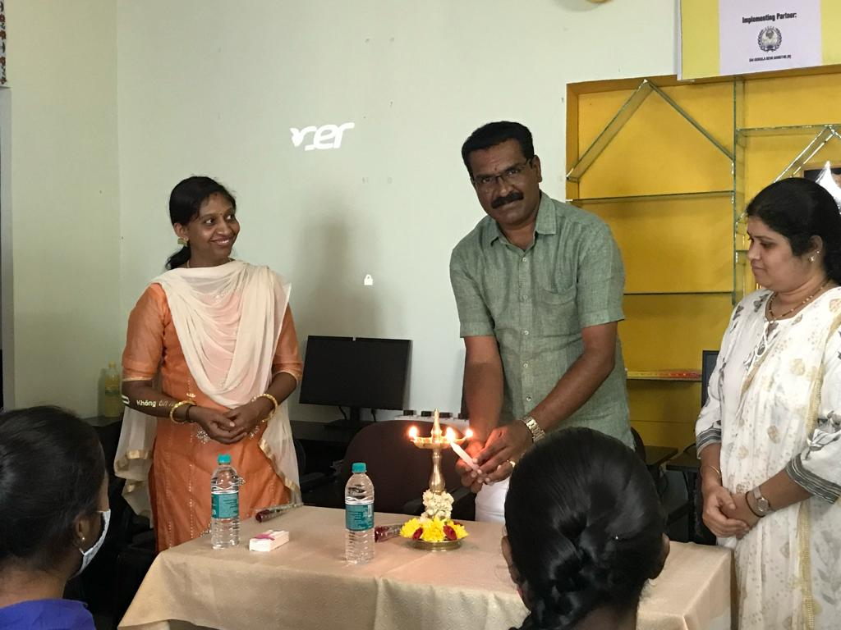

Slide 52
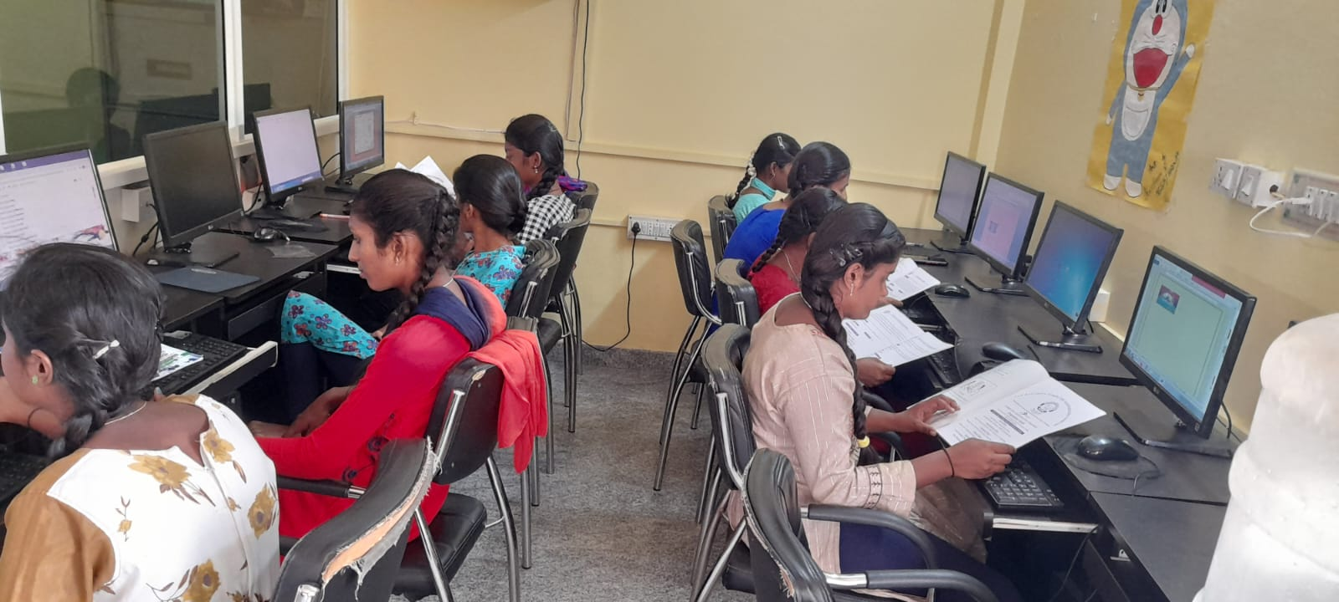
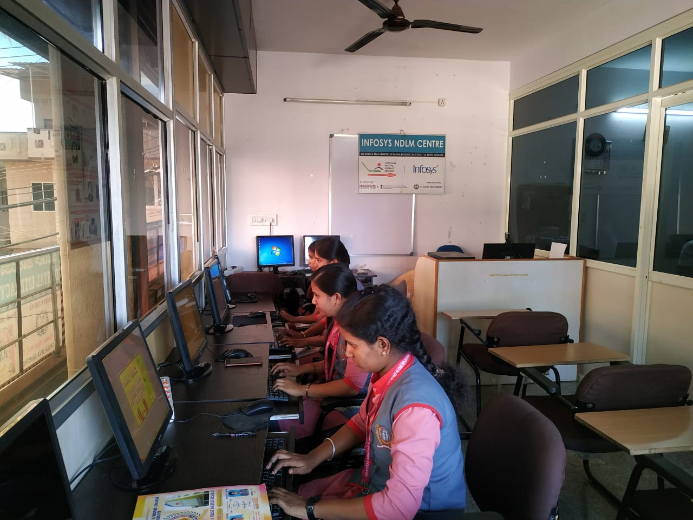
STUDENTS TRAINING ON NDLM CENTRES…

Slide 53
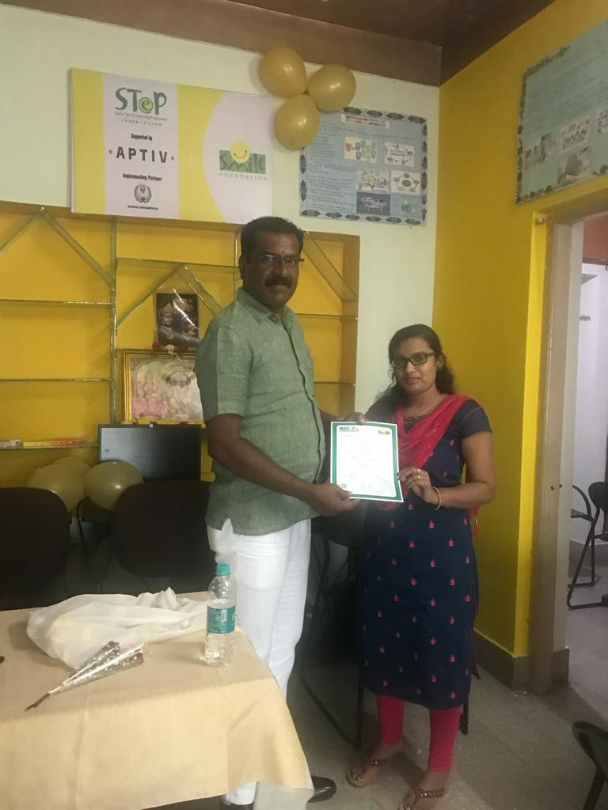
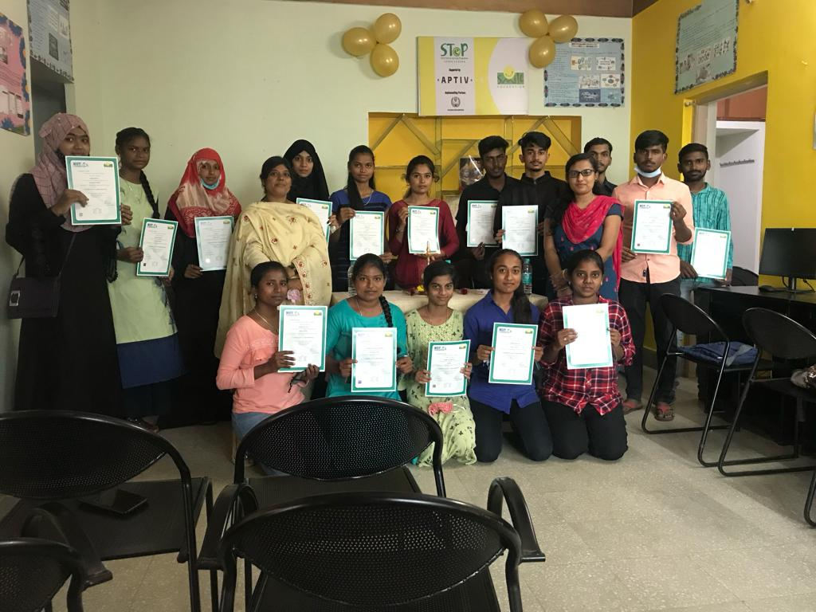
DISRTIBUTION OF CERTIFICATES TO OUR TRAINEES…

Slide 54
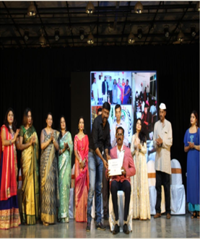
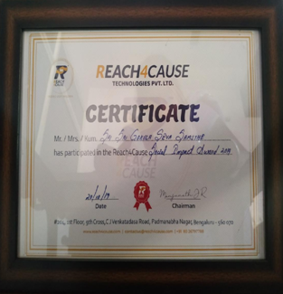
OUR ACHIEVEMENTS….

Slide 55
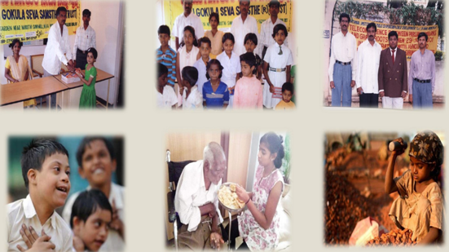

Slide 56
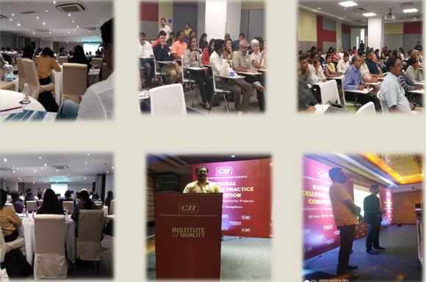

Slide 57
THANKYOU

